Slide 1

Drama At Cornwallis Academy
Year 7 – LESSON 5
Lesson Objective:
To investigate the use of Teamwork through Drama exercises.
To understand why team work is so important in drama.

Slide 2
Level | Drama Strand
 | Creating | Performing | Reflecting
Entry | I can take part in a drama activity | I can participate in part of a group performance | I can identify positive and negative aspects within my work
1 | I can take part in a range of drama activities I can explore problems in an imagined world and make up plays from stories or other stimuli | I can participate in a short group performance I show some consideration of movement and voice in performance | I can make simple connections between the dramas I experience and my own life I can recognise when my own work and the work of others’, could be improved
2 | I can perform my own simple scenes, demonstrating an understanding of drama techniques | I can use my voice and body to create a simple character I can act out improvised dramas | I can talk about why I made certain decisions in my play I can show a basic understanding of how meaning can be shown
3 | I can establish a character with control over movement and voice I can use the dialogue in existing texts as well as creating my own I can devise plays from a range of stimuli I can respond to the use of drama techniques to deepen the role or understanding of the situation e.g. hot seating I can sustain a defined character for a reasonable amount of time | I can learn lines and organise simple performances | I can give suggestions on how work could be improved I can talk about my work using some technical drama terminology I can discuss and give reasons for my preferences in the drama I have seen

Slide 3
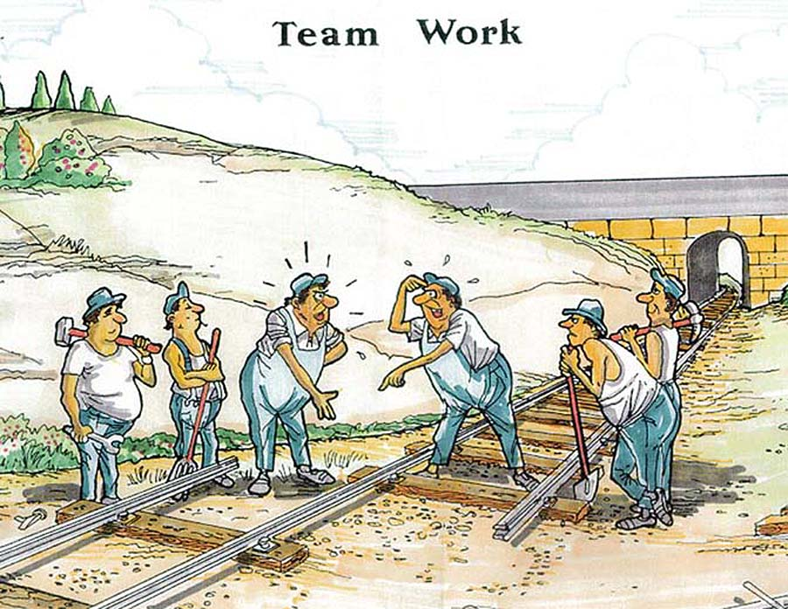
WHAT IS TEAMWORK?
Lesson Objective:
To investigate the use of Teamwork through Drama exercises.
To understand why team work is so important in drama
Teamwork is a joint action by a group of people, in which each person works to the unity and efficiency of the group. The most effective teamwork is produced when all the individuals involved harmonize their contributions and work towards a common goal.

Slide 4
THE CLAP
Lesson Objective:
To investigate the use of Teamwork through Drama exercises.
To understand why team work is so important in drama
All students stand in a circle.
As a whole class you must clap when the teacher claps.

Slide 5
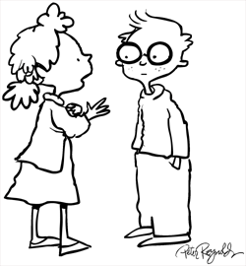

Lesson Objective:
To investigate the use of Teamwork through Drama exercises.
To understand why team work is so important in drama
RallyRobin
What skills have you used in the Clap task? The partner that has the smallest hands goes 1st.
After the 1st partner shares one thing, partner 2 shares one thing; repeat.
You “Rally” the topic like this until the teacher calls time.
It’s like a game of Word tennis.
If you are stuck for words ask Sir for help…a little or a lot.

Slide 6
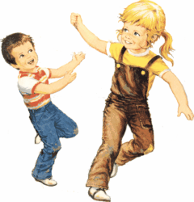
FORMATIONS
Lesson Objective:
To investigate the use of Teamwork through Drama exercises.
To understand why team work is so important in drama
Walk around the space.
When the teacher calls a number you must get into groups of that number with the people nearest to you.
The teacher will then ask you to make a shape, object or number with you group.
You must work as a team in order to complete the task as efficiently as you can.

Slide 7

Lesson Objective:
To investigate the use of Teamwork through Drama exercises.
To understand why team work is so important in drama
Timed Pair Share
Why were teamwork skills important in the Formations task?
You have 15 seconds “think time”.
In pairs, Partner A shares as Partner B listens.
Teacher calls “time”.
Partner B thanks and praises Partner A.
Partners switch roles.

Slide 8
CHASE THE TAIL
Lesson Objective:
To investigate the use of Teamwork through Drama exercises.
To understand why team work is so important in drama
In groups of four, students must stand in a line and place their hands on the shoulder of the person in front.
Each team must try to defend their own tail and take another teams tail.
Each team must have a tail attached to the person at the back of their line.
The person at the front of the line is the ‘Catcher’ and only they can take another teams tail.
If a team takes a tail they must shout ‘Tail’, the game then stops and restarts without that team.
If a team splits up during the game and their hands come off of the shoulders of their teammates they are out.
The last team left is the winner.

Slide 9
Lesson Objective:
To investigate the use of Teamwork through Drama exercises.
To understand why team work is so important in drama
Quiz-Quiz-Trade
Using question cards, students quiz a partner, get quizzed by a partner, then trade and repeat with a new partner:
Stand Up, Hand Up, Pair Up.
Partner A quizzes.
Partner B answers.
Partner A coaches and/or praises.
Switch roles.
Partners trade cards.
Repeat steps 1-6 until the teacher calls time.
HOW TO COACH
Tip
Tip
Tell
Explain

Slide 10
LESSON OUTCOMES How did you do today?
Lesson Objective:
To investigate the use of Teamwork through Drama exercises.
To understand why team work is so important in drama
LEVEL 3c - All students will know what Teamwork is.
LEVEL 3b - Most students will understand why Teamwork is an essential skill within Drama.
LEVEL 3a - Some students will be able to use Teamwork skills effectively within a Drama context.

Slide 11
SPOTLIGHTING
Lesson Objective:
To investigate the use of Teamwork through Drama exercises.
To understand why team work is so important in drama
Spotlight all groups and observe their work.
WWW – What Went Well?
What worked and why?
What could be improved? And why?

Slide 12
Lesson Objective:
To know what Devising from a Stimuli is.
To understand how to devise a performance using a stimuli.
Summing up:
THINK, PAIR, SHARE
What is TEAMWORK?
Why is TEAMWORK an important skill in Drama?
Did you use TEAMWORK effectively in today's lesson?
Get into a pair.
Tell your partner what you have learnt today.

Slide 13
THE DETECTIVE
Lesson Objective:
To know what Devising from a Stimuli is.
To understand how to devise a performance using a stimuli.
All students stand in a circle.
All students are playing as one person.
The detective will ask the students where they were at the time of the murder and other questions.
Students must listen and remember each others answers in case the detective asks the same question again.
If the detective catches you lying he will arrest for the murder.
Notes:
This is an extension task.

